Slide 1
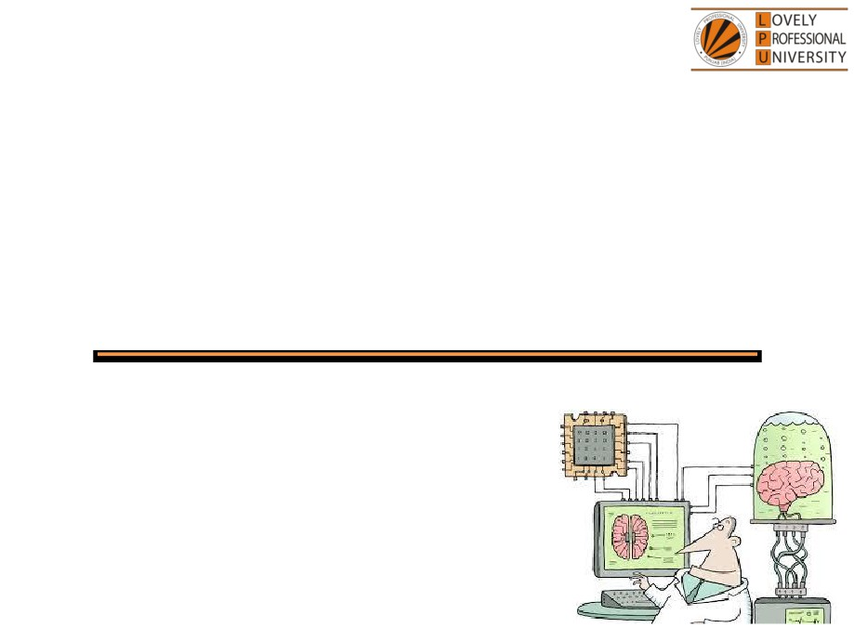
PEA305
Analytical Skills I
Lecture #0
Breaking the ice
Department of Analytical Skills

Slide 2

Course Details
LTP - 2 1 0 [Two lectures, One Tutorial per week]
Text Book
Quantitative Aptitude by Dr.R S Aggarwal
Reference Book
Quantitative Aptitude by M Tyra
Quantitative Aptitude by Abhijit Guha

Slide 3
Course Assessment Model
Marks break up
• Attendance
15
• CA
30
• MTE (MCQ)
15
• ETE (MCQ)
40
• Total
100
• MTE & ETE to be done on OMR sheets
All tests will be based on MCQ.

Slide 4
Course Outcomes
CO1 :: demonstrate procedural fluency with number system and mathematical operations to solve the stated problems.
CO2 :: select an appropriate approach to solve problems related to percentage, profit and loss.
CO3 :: observe the data given and interpret given number and alphanumeric series
CO4 :: apply the analytical concepts learnt to solve the questions of ratio and proportion
CO5 :: use the concepts of permutation, combination and probability to handle various problems.
CO6 :: analyze the reasoning aptitude problems such as blood relation and direction sense to solve related problems.

Slide 5
Course focus identification
Employability

Slide 6
Assessment and Evaluation Model
Assessment (Category) | Conducted Week
CA 1 (A0203) | Week 5 (Duration 45 Min Q 30)
MTE (11) | After week 7 (Duration 60 Minutes Q 40)
CA 2 (A0203) | Week 10 (Duration 45 Min Q 30)
CA 3 (A0203) | Week 14 (Duration 45 Min Q 30)
ETE (11) | After week 14 (Duration 120 Min Q 80)

Slide 7
Innovative evaluation strategies
Evaluation | Conduct
CA 1 | External
MTE | External
CA 2 | External
CA 3 | External
ETE | External

Slide 8
Unit wise course content
Unit I
Number system : HCF & LCM, divisibility rules, classification of numbers, factors, factorials, unit digit calculation, remainder properties
Simplification and approximation : BODMAS rule, calculation and approximation based on percentage, problem based on digit sum
Average : basic average calculations, average increase and decrease, weighted average
Unit II
Percentage : basic percentage calculations, percentage to fraction, percentage comparison, percentage increase and decrease, population change in percentage
Profit loss discount : basic concepts of cost price selling price and marked price, calculations of profit and loss percentage, types of discount and discount percentages, comparison of profit or loss with discount percentage
Unit III
Logical reasoning : number series with introduction of AP and GP, alphabet series, alphabet test, coding and decoding, language coding

Slide 9
Unit IV
Ratio and proportions : basic concepts of ratio and proportions and ages, problems based on ratio and proportions and ages, problems based on partnerships and profit sharing
Alligation and mixtures : conceptual knowledge of alligation and mixtures, problems based on alligation and mixtures
Unit V
Permutation : basic principle of counting, numerical permutation(formation of numbers and sum of numbers), alpha permutation(rearrangement of words and rank of a word), linear and circular permutation, logical permutation
Combination : basic formulas of combination, formation of committee, combination of identical objects
Probability : concept of probability, classification of events, conditional probability, problems based on coins dices and cards
Unit VI
Analytical reasoning : blood relations, direction sense test
Simple and compound interest : basic concepts of interest calculations, comparison of simple and compound interest

Slide 10


Let us look around…
Why every organization takes Quantitative Aptitude Tests before hiring any future employee…

Slide 11
Right Decision Making
Mental Alertness
Ability to quickly interpret data
Establish logical relationship
Arrive at the correct conclusions
Make the right judgment

Slide 12
Organizations recruit people who have
Quick Mental Abilities.
PEA502 Analytical Skills-II :: Vishal Ahuja

Slide 13
How you will make your mental ability Quick…!!!
Quick = Tricks
PEA502 Analytical Skills-II :: Vishal Ahuja

Slide 14
123456^654321
Find the unit digit

Slide 15
And What about this….?
In how many ways the committee of 5 members be formed out of 7?

Slide 16

5 minute…???
10 minutes…???
15 minutes…???
20 minutes…???
Again…!!! It will not take more than 30 SECONDS.

Slide 17
A person invested a sum of Rs.750 in a bank at simple interest. After 5 years he received Rs.1200. Find the rate of interest offered by the bank.
What do we need to know?

Slide 18
What do we need to know?
This course PEA305 : Analytical Skills-I
Ability to efficiently solve the company specific Quantitative
Aptitude Tests.
Ability to prioritize and manage Time.
Ability to efficiently analyze data.

Slide 19
Edu-Revolution: Be the Change Initiatives
EDU-Revolution Categories
Revenue Generation
Social Media Presence
Project
Recognition of Prior Learning
NPTEL/MOOC
Grade Upgradation (Core/Non-Core)
Internship Beyond the Curriculum
Community Service
Co-curricular/Extra curricular activities
10% Attendance Benefit
Duty Leave
Earn Extra Credit

Slide 20
Edu-Revolution: Be the Change Initiatives
EDU-REVOLUTION:
bringing in a transformative shift in education
Students will be offered a variety of learning options
the initiatives will be designed to provide flexibility in key academic areas
This initiative will address the following key aspects:
[A] Course Equivalence and Attendance Relaxation
[B] Grade Revision and Overall Welfare (GROW)
[C] 10 % Attendance waiver for students in Pre-final/Final year of the programme
[D] Continuous Assessment Reduction Through Experience (CARE)
[E] Students in active decision-making through Student Committees
PEA-221 Analytical Skills :: Department of Analytical Skills

Slide 21
[A] Course Equivalence and Attendance Relaxation:
The students will be provided an opportunity to seek attendance relaxation and course equivalence for some courses registered to him/her in the upcoming term through various platforms as detailed below.
Recognition of Prior Learning (RPL):
Students who believe they already possess the required knowledge or skills in a course, can request relaxation from the course and attendance via an online interface. This will be applicable for basic elementary courses such as English, Mathematics, Analytical skills, Soft skills etc.
2. NPTEL Course/MOOCs/Certifications:
A student can request for course and attendance relaxation in upcoming term’s course in lieu of any NPTEL Course/MOOCs/Certifications he/she wishes to pursue in that term.
3. Pursuing Project: Students wishing to pursue project against any course of upcoming term may receive course equivalence and attendance relaxation.
PEA-221 Analytical Skills :: Department of Analytical Skills

Slide 22
[B] Grade Revision and Overall Welfare (GROW):
The students will now be extended an opportunity to improve their existing grade(s) through various other learning options as:
Competitions/Hackathons
2. Entrepreneurial Venture
3. Publications/Patents/Copyrights
4. Performance in higher studies, Recruitment Exam (GATE/ JAM, UGC-NET, CAT, AFCAT, CDS, IELTS, CTET etc.)
5. Projects/consultancy taken in collaboration with NGO/agency for social service
6. Social Media Presence (Blogs/Vlogs created and posted on various social media platforms)
PEA-221 Analytical Skills :: Department of Analytical Skills

Slide 23
[C] 10 % Attendance waiver for students in Pre-final/Final year of the programme:
Students with a CGPA of 8 or higher can apply for an attendance relaxation in their pre-final/final year. Eligible students will be granted a 10% attendance relaxation to support their career development.
[D] Continuous Assessment Reduction through Experience (CARE):
Students who are wishing to explore innovative learning methods or alternative approaches may apply for CA modifications by opting for real-life problem-solving assignments, social service, blogs, vlogs on social media etc .
PEA-221 Analytical Skills :: Department of Analytical Skills

Slide 24
E] Students in active decision-making through Student Committees
Students will be actively involved in decision-making related to academic and learning procedures applicable to them, by becoming a member of various committees as listed below:
a. Student Academic and Project Review Committee
b. Student Career Committee
c. Student entrepreneurship and Media Committee
The students can submit their nominations through UMS for becoming members of their desired committee.
UMS link to apply for all the above-mentioned initiatives:
UMS Navigation --- LMS EDU Revolution: BE THE CHANGE
PEA-221 Analytical Skills :: Department of Analytical Skills

Slide 25


Next Class: Number System

